Slide 1
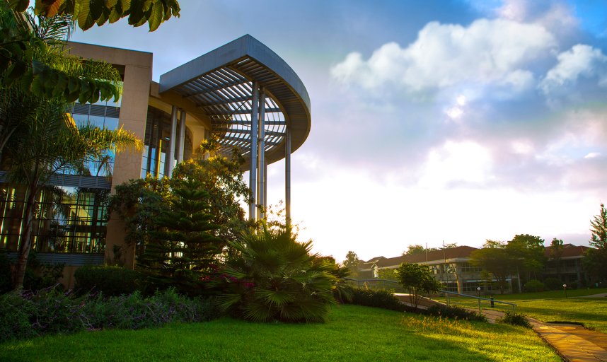


Slide 2
USIU-Africa: Your Gateway to Global Excellence
1953-1969
Opened branches in Mexico City (Mexico), Tokyo City (Japan) and London City (United Kingdom) with the Nairobi City (Kenya) being established in 1969
Founded on principles of academic excellence and profound cultural diversity.
1952
FOUNDED by
Dr. William Rust, in San Diego, California, USA
1970
NAIROBI CAMPUS commenced operations

Slide 3


Our Brand Promise: Nurturing Future-Ready Leaders
Our Vision is “To be the premier institution of academic excellence with a global perspective."
Our Mission is “To promote the discovery and application of knowledge, the acquisition of skills, and the development of intellect and character in a manner that prepares students to contribute effectively and ethically as citizens of a changing and increasingly technological world."

Slide 4
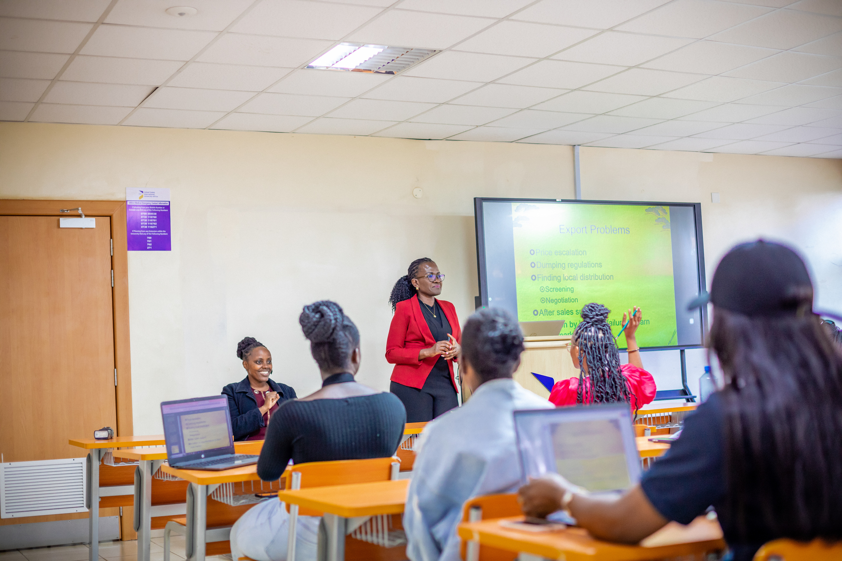
Why USIU-Africa: Our Distinct Advantages
Globally Recognized Education
Optimal Faculty-Student Ratio: 1:20
We provide dual-accredited education approved in USA and Kenya by WASCUC and CUE respectively, ensuring your degree opens doors internationally
Experience truly personalized education with our exceptional 1:20 faculty-student ratio that ensures close interaction, dedicated mentorship, and an environment where every student receives the attention needed to excel academically and personally.

Slide 5


Why USIU-Africa: Our Distinct Advantages
Vibrant Cultural Diversity
State-of-the-art Campus
With students from over 70 nationalities, USIU-Africa is a living microcosm of the global community. Immerse yourself in a rich tapestry of cultures, preparing you for successful navigation of the interconnected global workplace and society.
Learn in an environment designed for the future: modern classrooms, dynamic innovation hubs, cutting-edge research centers, and an extensive digital library. Our campus offers a green, secure, and tech-enabled setting that fosters discovery and collaboration.

Slide 6



Why USIU-Africa: Our Distinct Advantages
Dynamic Co-Curricular Activities
Accessible Financial Aid
Engage in over 20 competitive sports, vibrant leadership clubs, and innovative arts societies. At USIU-Africa, we believe in holistic development that extends far beyond academic achievements.
Accessible through 30 programs, students benefit from merit-based, need-based, and special talent scholarships or financial aid, investing in their future success.

Slide 7



Why USIU-Africa: Our Distinct Advantages
Unique & In-Demand Programs
Powerful Global Alumni Network
Specialized programs that equip and produce graduands equipped with practical knowledge that address critical global needs.
A thriving and robust global community of over 25,000 Alumni professionals that provide invaluable mentorship, networking, and career advancement opportunities long after graduation.

Slide 8
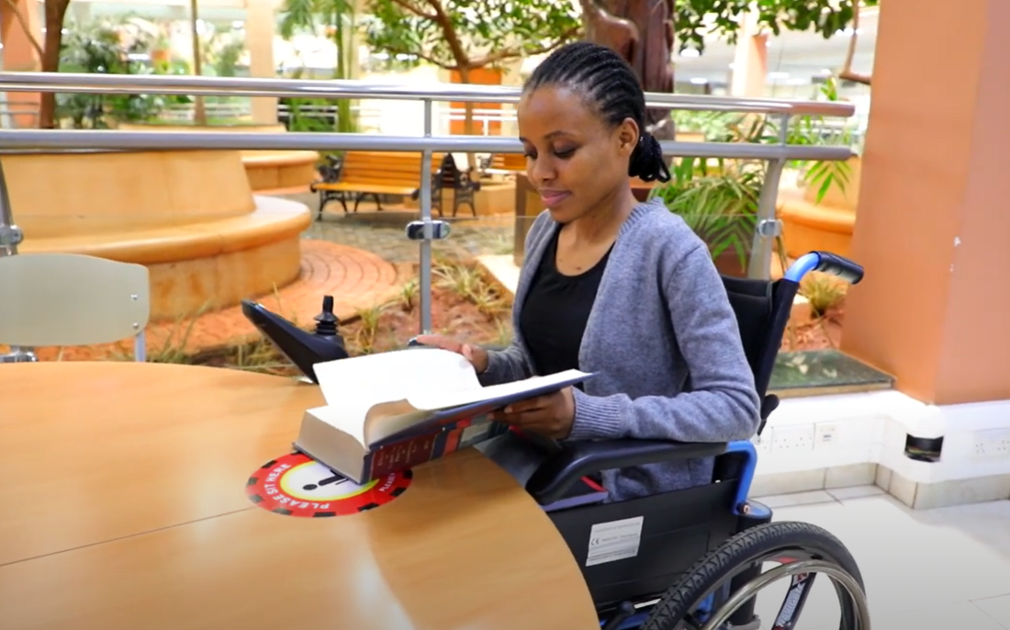
Why USIU-Africa: Our Distinct Advantages
International Exchange Programs
Inclusive & Innovative Community
Broaden your horizons through partnerships spanning 5 continents. Opportunities for study abroad, joint research, and faculty exchanges provide invaluable global exposure and experience.
USIU-Africa champions accessibility, equality, and inclusivity for all. We provide dedicated comprehensive support system and resources for persons with disabilities, ensuring all have an opportunity to thrive and succeed in a welcoming environment.

Slide 9
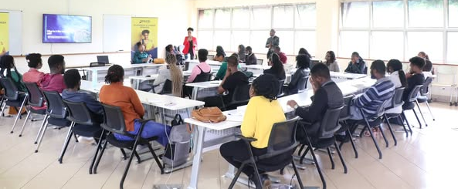
Why USIU-Africa: Our Distinct Advantages
Exceptional Career Services & Placement
Our dedicated Career & Placement Services Office bridges the gap between talent and opportunity, connecting students with top employers to become impactful contributors on the international stage. We are proud that 95% of our graduates are employed within 12 months of completing their studies, a testament to their preparedness and our strong industry linkages.

Slide 10
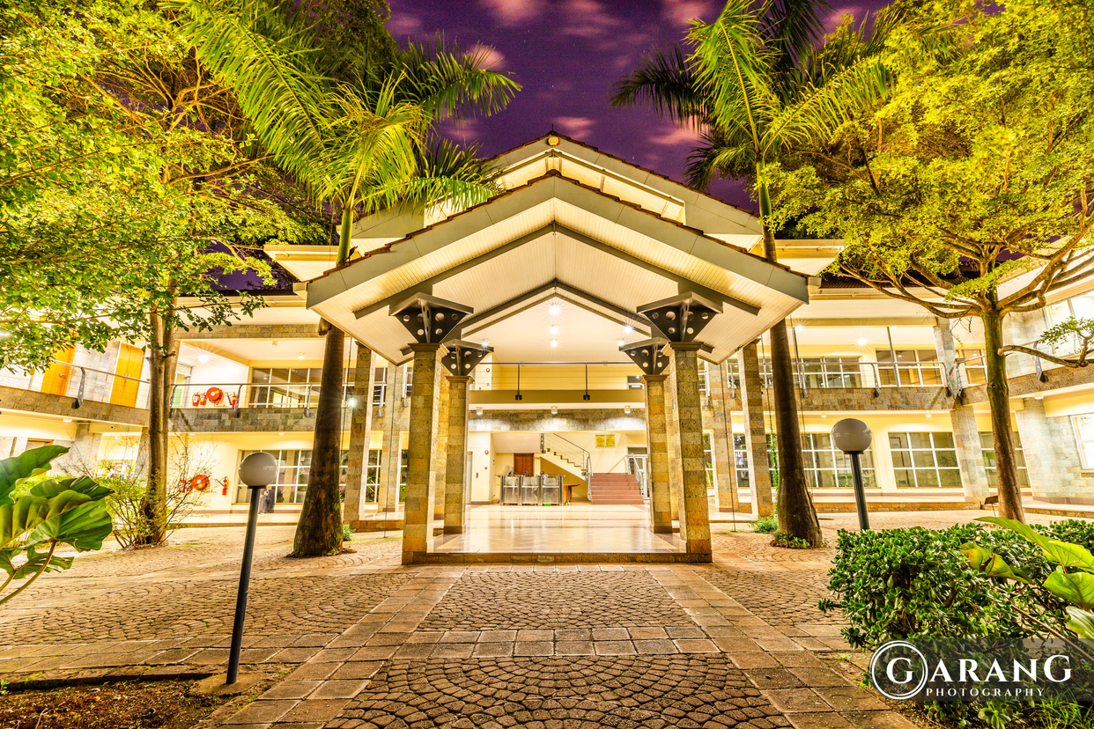
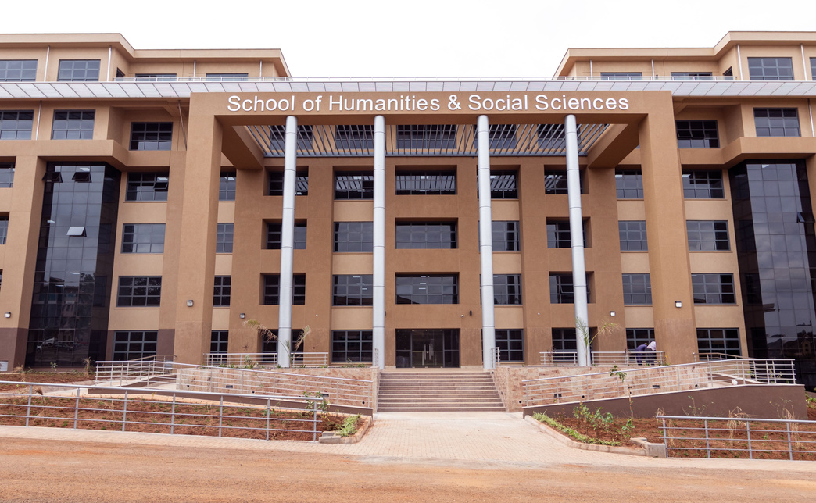

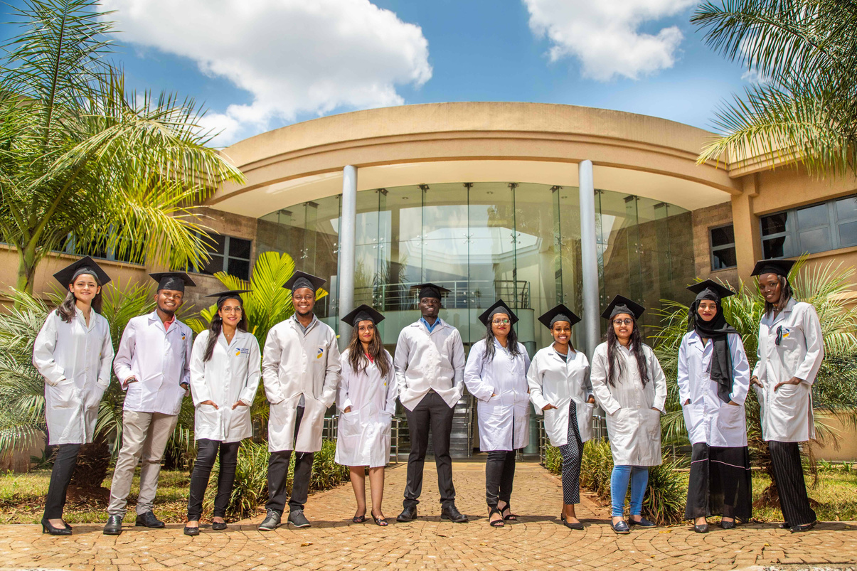



Our Schools and Programs on offer
CHANDARIA SCHOOL OF BUSINESS (CSOB)
SCHOOL OF HUMANITIES
& SOCIAL SCIENCES (SHSS)
SCHOOL OF SCIENCE &
TECHNOLOGY (SST)
SCHOOL OF PHARMACY & HEALTH SCIENCES (SPHS)
SCHOOL OF COMMUNICATION, CINEMATIC & CREATIVE ARTS (SCCCA)
BSc. Accounting
BSc. Finance
BSc. International Business Administration
BSc. Hotel and Restaurant Management
Master of Business Administration
MBA – Global Business Management / Health Leadership and Management
MSc. Management and Organizational Development
MSc. Global Banking & Finance
Doctor of Business Administration
BA. Criminal Justice Studies
BA. International Relations
BA. Psychology
MA in International Relations
MA in Marriage and Family Therapy
MA in Clinical Psychology
MA in Counseling Psychology
MA Criminal & Transitional Justice
Doctor of Philosophy in International Relations
Doctor of Psychology, (Psy.D), Clinical Psychology
BSc. Artificial Intelligence and Robotics
BSc. Information Systems and Technology
BSc. Applied Computer Technology
BSc. Software Engineering
BSc. Data Science & Analytics
MSc. Data Science & Analytics
MSc. Information Systems and Technology
MSc. Information Security
PhD. Information Systems & Technology
Bachelor of Science in Nursing
Bachelor of Pharmacy
BSc. Epidemiology & Biostatistics
BA. Journalism
BA. Animation
BA. Film Production and Directing
MA Communication Studies
SCHOOL OF GRADUATE STUDIES (SGS)

Slide 11


Entry Requirements
Fee Schedule
Access the fee structure via:
www.usiu.ac.ke/fee-schedule
Undergraduate:
• KCSE: C+ (plus) and above or its equivalent

Slide 12
USIU-AFRICA INTAKES
JANUARY
MAY
SEPTEMBER

Slide 13
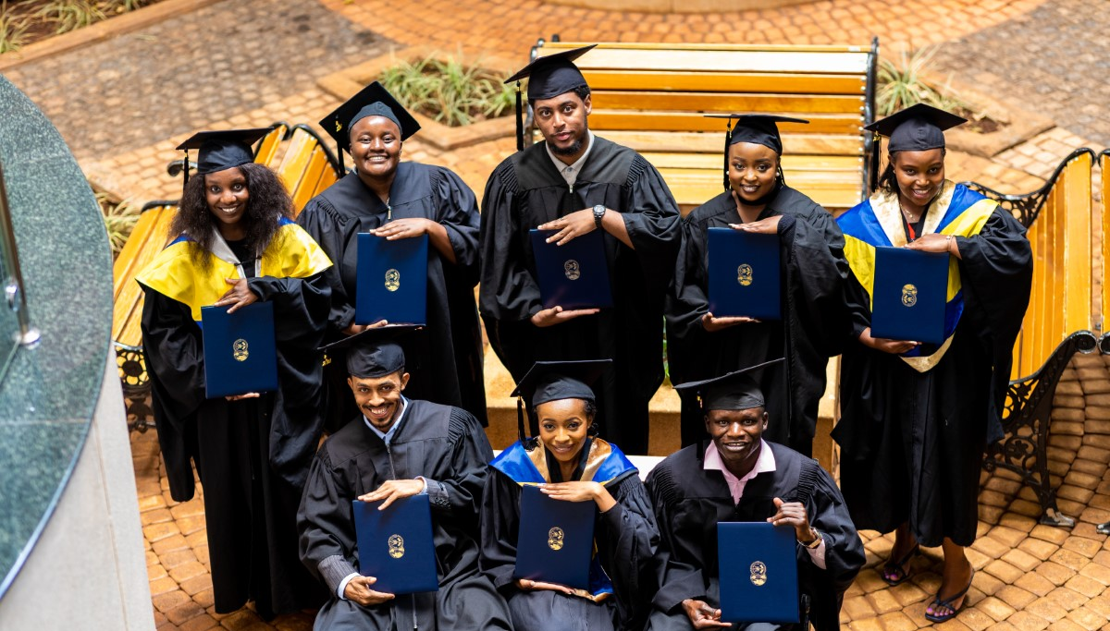


Join USIU-Africa and experience ‘Education To Take You Places’.
Website: www.usiu.ac.ke | Email: admit@usiu.ac.ke | Phone: +254 730 116 290/291

